Slide 1

Control Statements

Slide 2
Agenda
In this session, you will learn about:
if statement
while statement
for
do-while
continue
break

Slide 3
Control Statements
Java’s Selection Statements
Control statements can be put into the following categories:
selection, iteration, and jump.
Selection statements allow your program to choose different paths of execution based upon the outcome of an expression or the state of a variable.
Iteration statements enable program execution to repeat one or more statements (that is, iteration statements form loops).
Jump statements allow your program to execute in a nonlinear fashion. All of Java’s control statements are examined here.

Slide 4
Java’s Selection Statements
If
Java supports two selection statements: if & switch.
These statements allow you to control the flow of your program’s execution based upon conditions known only during run time.
The if statement is Java’s conditional branch statement.
It can be used to route program execution through two different paths.
The if works like this: If the condition is true, then statement1 is executed. Otherwise, statement2 (if it exists) is executed.
if(condition){
//Statement 1
}else{
//Statement 2
}

Slide 5
Java’s Selection Statements
If
int numberOfDays=0;
String firstName ="Hello";
String secondName ="hello";
//number comparision
if(numberOfDays == 10) {}
//String comparision
if(firstName.equals(secondName)) {}
//String comparision ignore case
if(firstName.equalsIgnoreCase(secondName)) {}

Slide 6
Java’s Selection Statements
The if-else-if ladder
if(condition1){
//Statements
}else if(condition2){
//Statements
}else if(condition3){
//Statements
}else{
//Statements
}

Slide 7
Java’s Selection Statements
The if-else-if ladder
The if statements are executed from the top down.
As soon as one of the conditions controlling the if is true, the statement associated with that if is executed, and the rest of the ladder is bypassed.
If none of the conditions is true, then the final else statement will be executed.The final else acts as a default condition; that is, if all other conditional tests fail, then the last else statement is performed.
If there is no final else and all other conditions are false, then no action will take place.

Slide 8

Exercise
Month | Season
1 | Winter
2 | Spring
3 | Spring
4 | Spring
5 | Summer
6 | Summer
7 | Summer
8 | Autumn
9 | Autumn
10 | Autumn
11 | Autumn
12 | Winter
Print Season based on month
Get Month as number input(1-12) and print Season based on table given.

Slide 9
Java’s Selection Statements
Switch
The switch statement is Java’s multiway branch statement.
It provides an easy way to dispatch execution to different parts of your code based on the value of an expression.
As such, it often provides a better alternative than a large series of if-else-if statements.

Slide 10
Java’s Selection Statements
Switch
switch (expression) {
case value1:
// statement sequence
break;
case value2:
// statement sequence
break;
.
.
.
case valueN:
// statement sequence
break;
default:
// default statement sequence
}
If break is not provided between case, The next statement will be executed regardless of condition.
The default should always be the last statement of switch case.

Slide 11
Java’s Selection Statements
Switch - Demonstration
Scanner scanner = new Scanner(System.in);
System.out.println("Enter Value of i");
int i = scanner.nextInt();
switch (i) {
case 0:
System.out.println("i is zero.");
break;
case 1:
System.out.println("i is one.");
break;
case 2:
System.out.println("i is two.");
break;
case 3:
System.out.println("i is three.");
break;
default:
System.out.println("i is greater than 3.");
}
Notes:
semester2\1-java8\1-coding-fundamentals-oops-control-statements\2-class-exercises-and-demos\coding-fundamentals\src\com\imarticus\tutorial\codingfundamentals\demos\controlstatements\SwitchStatementDemo.java

Slide 12
Java’s Iteration Statements
While
Java’s iteration statements are for, while, and do-while.
These statements create what we commonly call loops.
The while loop is Java’s most fundamental loop statement.
It repeats a statement or block while its controlling expression is true.
The condition can be any Boolean expression.
The body of the loop will be executed as long as the conditional expression is true.
When condition becomes false, control passes to the next line of code immediately following the loop.
while(condition) { // body of loop }

Slide 13
Java’s Iteration Statements
While - Demonstration
// Demonstrate the while loop.
int n = 10;
while (n > 0) {
System.out.println("tick " + n);
n--;
}
Notes:
semester2\1-java8\1-coding-fundamentals-oops-control-statements\2-class-exercises-and-demos\coding-fundamentals\src\com\imarticus\tutorial\codingfundamentals\demos\controlstatements\WhileStatementDemo.java

Slide 14
Java’s Iteration Statements
do-while
The do-while loop always executes its body at least once, because its conditional expression is at the bottom of the loop.
do {
// body of loop
} while (condition);
Each iteration of the do-while loop first executes the body of the loop and then evaluates the conditional expression.
If this expression is true, the loop will repeat.
Otherwise, the loop terminates. As with all of Java’s loops, condition must be a Boolean expression.

Slide 15
Java’s Iteration Statements
For loop
The For loop first starts when the initialization portion of the loop is executed.
Generally, this is an expression that sets the value of the loop control variable, which acts as a counter that controls the loop..
It usually tests the loop control variable against a target value.
If this expression is true, then the body of the loop is executed.
If it is false, the loop terminates.
Next, the iteration portion of the loop is executed.
This is usually an expression that increments or decrements the loop control variable.
The loop then iterates, first evaluating the conditional expression, then executing the body of the loop, and then executing the iteration expression with each pass.
This process repeats until the controlling expression is false.

Slide 16
Java’s Iteration Statements
For loop – Print Numbers till 5
//Print numbers of loop till 5
int i;
int totalNumbers = 5;
System.out.println("Printing numbers from 1 to " + totalNumbers);
//for initialization ; a condition ; an increment or decrement
for (i = 1; i <= totalNumbers; i++) {
System.out.println(i);
}
Notes:
semester2\1-java8\1-coding-fundamentals-oops-control-statements\2-class-exercises-and-demos\coding-fundamentals\src\com\imarticus\tutorial\codingfundamentals\demos\controlstatements\ForLoopDemo.java

Slide 17
Java’s Iteration Statements
For each version of the for loop
The for-each style for automates the preceding loop.
Specifically, it eliminates the need to establish a loop counter, specify a starting and ending value, and manually index the array.
Instead, it automatically cycles through the entire array, obtaining one element at a time, in sequence, from beginning to end.

Slide 18
Java’s Iteration Statements
For each version of the for loop- Demonstration
//This is array
int nums[] = { 1, 2, 3, 4, 5, 6, 7, 8, 9, 10 };
int sum = 0;
// use for-each style for to display and sum the values in array
for (int x : nums) {
sum += x;
}
System.out.println("Sum of values in array: " + sum);

Slide 19
Jump Statements
Using Break
Java supports three jump statements: break, continue, and return.
These statements transfer control to another part of your program
Using break In Java, the break statement has following uses.
It terminates a statement sequence in a switch statement.
It can be used to exit a loop.
for (int i = 1; i <= 5; i++) {
if(condition){
break;
// No more loop
}
}

Slide 20
Jump Statements
Using continue
In order to force an early iteration of a loop. There might be need to continue running the loop but stop processing the remainder of the code in its body for this particular iteration.
The continue statement is just past the body of the loop, to the loop’s end.
In while and do-while loops, a continue statement causes control to be transferred directly to the conditional expression that controls the loop.
In a for loop, control goes first to the iteration portion of the for statement and then to the conditional expression.

Slide 21
Jump Statements
Print numbers upto 5 except 3
int i;
int totalNumbers = 5;
System.out.println("Printing numbers (except 3) from 1 to " + totalNumbers);
for (i = 1; i <= totalNumbers; i++) {
if(i == 3)
continue;
System.out.println(i);
}
The condition i equals 3 temporarily suspend that iteration
Which makes the loop to print all elements except 3
Notes:
semester2\1-java8\1-coding-fundamentals-oops-control-statements\2-class-exercises-and-demos\coding-fundamentals\src\com\imarticus\tutorial\codingfundamentals\demos\controlstatements\ContinueStatementDemo.java

Slide 22
Exercise
Print numbers from 1 to 12,
Don’t print number , if its divisible by 3
break the loop , if its divisible by 10

Slide 23
Jump Statements
return
The return statement is used to explicitly return from a method.
That is, it causes program control to transfer back to the caller of the method.
At any time in a method the return statement can be used to cause execution to branch back to the caller of the method.
Thus, the return statement immediately terminates the method in which it is executed.

Slide 24
Jump Statements
Return - Demonstration
public static void main(String args[]) {
boolean t = true;
System.out.println("Before the return.");
if (t)
return; // return to caller
System.out.println("This won't execute.");
}

Slide 25

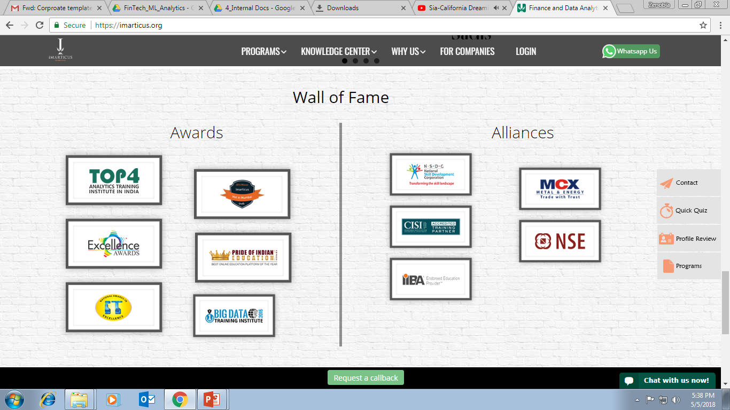



AWARDS:
Learn more:
https://imarticus.org/corporate/
Email us:
info@imarticus.com
Connect with us:
www.linkedin.com/company/imarticuslearning
ACCREDITED TRAINING PARTNER:
Watch us:
www.youtube.com/ImarticusLearninginstitute
Visit us:
Mumbai | Thane | Pune | Bangalore | Delhi - NCR | Hyderabad | Chennai | Coimbatore

